Slide 1
NoRD: Node-Router Decoupling for Effective Power-gating of On-Chip Routers
Lizhong Chen - Timothy M. Pinkston - 2012
Ming Hsieh Department of Electrical Engineering
University of Southern California Los Angeles, CA

Slide 2
Outline
Context and Motivation
Proposed design
Evaluation
Conclusion

Slide 3
Context
Power off the router
Buffer empty and notifying all of neighbors by PG signal
Awake the router when
Any neighbors assert WU signal
Neighbors wait for PG signal to clear
Effectiveness subject to
Wakeup latency (~12 cycles for router)
Breakeven-time (BET)
The minimum number of consecutive gated-off idle cycles to offset power-gating energy overhead (~10 cycles for router)
Router
C
WU
PG
Router
A
WU
Router
B
WU
Router
D
PG
PG
WU
PG
Router
E

Slide 4
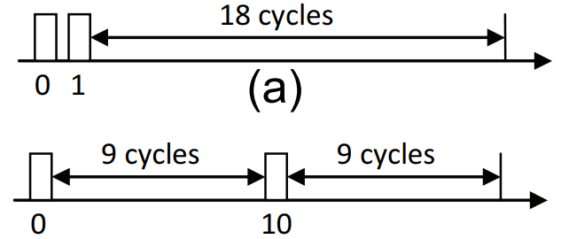
Motivation
BET limitation is intensified
61% of the total number of idle periods has length less than BET!
Cumulative wakeup latency in multi-hop NoCs
Disconnection problem
Node 2
0
1
2
3
The reason: node-router dependence
S
D
NoRD (Node-Router Decoupling) - a novel approach that provides separate power-gating bypass to decouple the node’s ability for transferring packets from the status of the router.
4
5
6
7
8
9
10
11
12
13
14
15
Notes:
Intermittent packet arrivals => fragmented idle intervals
any packet (sent, received or forwarded) must wake up the router before being transfer red, thus breaking the potentially long idle period into fragmented intervals.

Slide 5
Outline
Context and Motivation
Proposed design
Evaluation
Conclusion

Slide 6
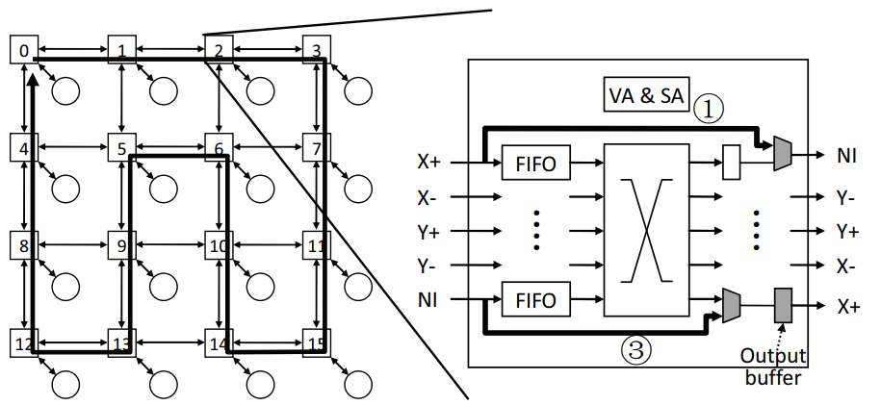
NoRD Bypass Paths
Add two bypass paths to each router
One bypass from Bypass Inport to the NI ejection
One bypass from the NI injection to Bypass Outport
Chip-level Bypass Ring
Bypass datapath in router

Slide 7
NoRD Bypass Paths
State-transitions
On -> off, when the datapath of router is empty
Off -> on, when a wakeup metric exceeds a threshold
①
③
Network Interface
Low implementation cost of decoupling bypass paths and forwarding logic: 3.1% of router area

Slide 8
NoRD routing
Based on Duato’s Protocol for fully adaptive routing
Minimal path along gated-on routers & gated-off routers
0
1
2
3
S
D
4
5
6
7
D
8
9
10
11
12
13
14
15

Slide 9
NoRD routing
Based on Duato’s Protocol for fully adaptive routing
Minimal path along gated-on routers & gated-off routers
Limited misroutes possible only if all routers off along min path
Bypass Ring serves as “escape path”
0
1
2
3
S
4
5
6
7
D
8
9
10
11
12
13
14
15
D

Slide 10
Increasing NoRD Efficiency
Differentiate routers
Routers have different impact on performance based on their locations in the NoC
Performance-centric class vs. Power-centric class
Wake up early a few performance-critical
routers to add “shortcuts” in routing
Wake up late the rest (majority) of the
routers to save more static power
Use an off-line program to classify
the routers
0
1
2
3
4
5
6
7
8
9
10
11
12
13
14
15

Slide 11
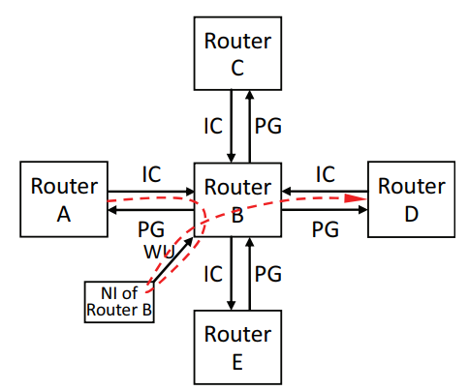
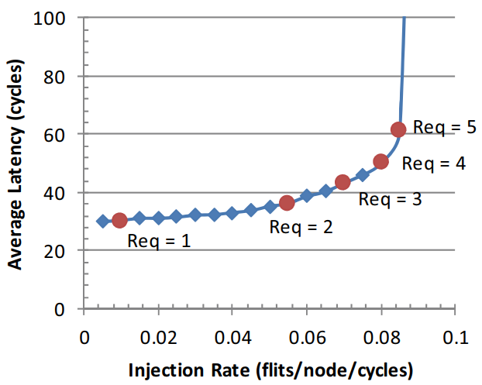
Router states transition
Power-off router B
IC and WU are clear
Routers C, D, E tag output
Router A sets the credit of each VC in that output port to 1 as router B now has only one output buffer available
Power-on router B
WU signal active: according to the wake-up threshold (when the load is high)
Routers C, D, E reset
Wake-up threshold
VC request rate

Slide 12
Outline
Context and Motivation
Proposed design
Evaluation
No_PG - No power-gating
Conv_PG - Conventional power-gating
Conv_PG_OPT - Early wakeup optimization power-gating
NoRD - Node-router decoupling
Conclusion

Slide 13
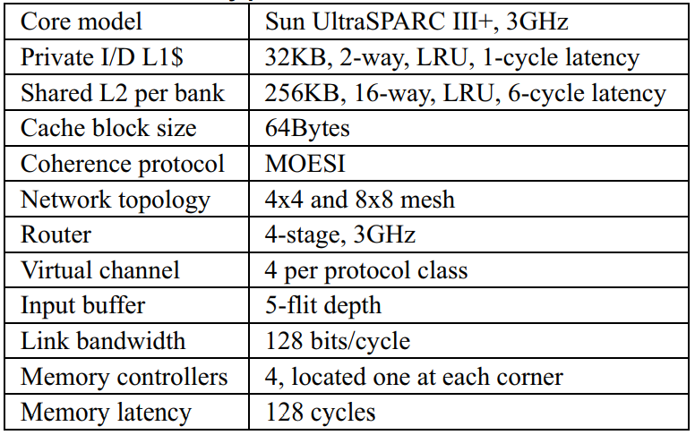
Environment
Core 90 mn

Slide 14
Evaluation
Static energy saved
Conv_PG: 51.2%, Conv_PG_OPT : 47.0%, NoRD: 62.9%
NoRD reduces power-gating overhead and number of router wakeups by over 80%
Overall NoC energy saved
Conv_PG: 9.4%, Conv_PG_OPT: 9.1%, NoRD: 20.6%
Static energy savings exceed dynamic energy losses
Average packet latency penalty
Conv_PG: 63.8%, Conv_PG_OPT: 41.5%, NoRD: 15.2%
Execution time penalty
Conv_PG: 11.7%, Conv_PG_OPT: 8.1%, NoRD: 3.9%

Slide 15
Conclusion: NoRD
Optimization
Significantly reduces the number of power state transitions
Increases the length of idle periods
Completely hides the wakeup latency from the critical path
Eliminates network disconnection problems
Limitation
Maybe increases the packet latency by detouring it to a neighbour router
NoRD is not scalable for large NoC
Reduce the router static energy by 29.9% and improve the average packet latency by 26.3%, with only 3% additional area overhead.

Slide 16
Thank you for your attention

